Slide 1


Introduction to Power Analysis
Soumi Chatterjee
Department of Computer Science and Engineering, IIT Kharagpur
12/02/25

Slide 2
Flowchart For Side Channel Analysis
Perform Analysis on the collected Data
Identify Critical Points in the Algorithm
04
01
03
Executing the Algorithm on Target Board
Collect Side Channel Information via. Power/EM
02

Slide 3
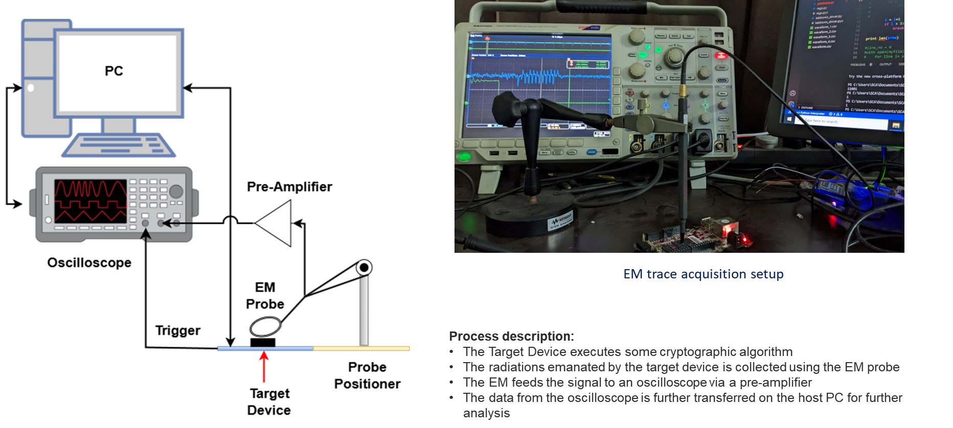
Side Channel Analysis Infrastructure
Separate Class for Chipwhisperer

Slide 4
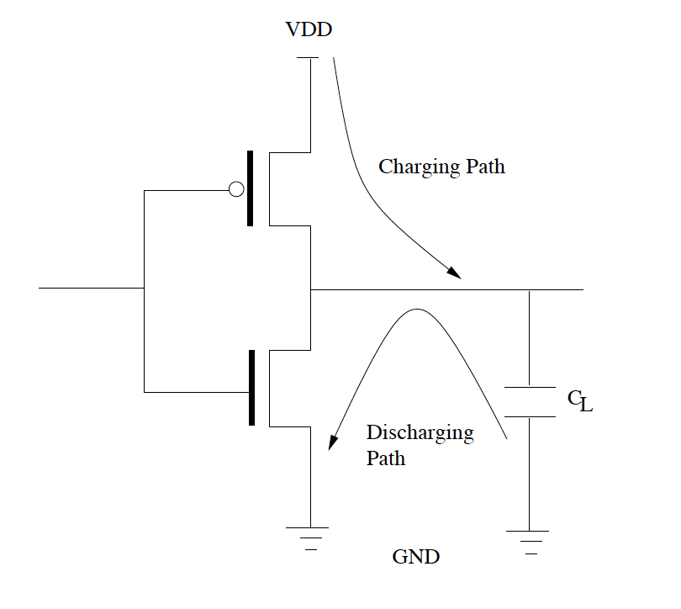
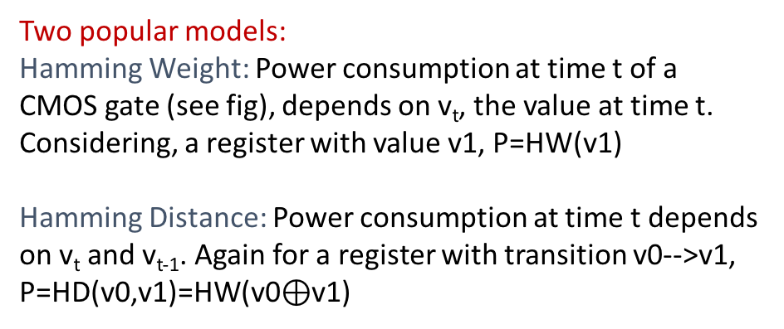
Power Models
Power analysis depends largely on power simulation, which predicts the power variation of a device wrt. the change of internal values.
The internal value is often computed from the ciphertext and the assumed portion of the key, and the power model which maps the internal value to a power level.
More than the actual value, relative predictions are most important.

Slide 5
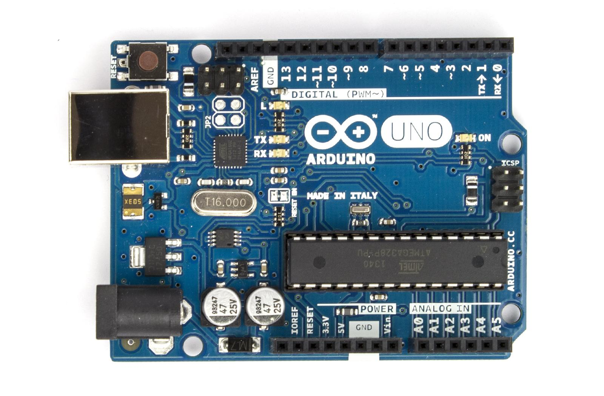
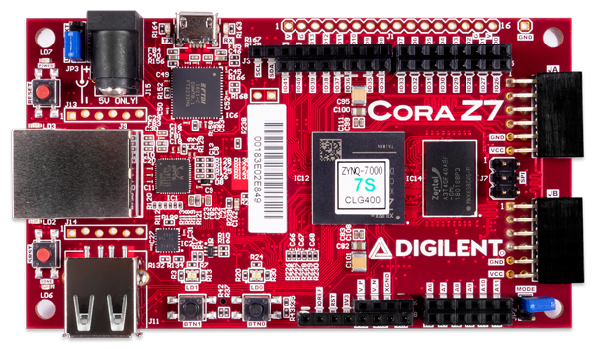
Which Model suits which device ?
A precharge circuit is used to limit inrush current when device is turned on to slowly charge the downstream capacitance. It plays a critical role in the proper operation and protection of components in high voltage applications.
In microcontrollers, pre-charging occurs, leading to registers being cleared before loading new data; hence, the hamming weight model is used.
In FPGAs, pre-charging is typically not implemented, meaning register values are not cleared before loading new data; therefore, the Hamming distance model is preferred.

Slide 6
Power Attacks
SPA – Simple Power Analysis attacks
Fact exploited - Power consumption at an instant of time is a function of the operation being carried out by the device
DPA – Differential Power Analysis
Fact exploited - Power consumption of the same operation at different instants of time depends on the data being processed.

Slide 7
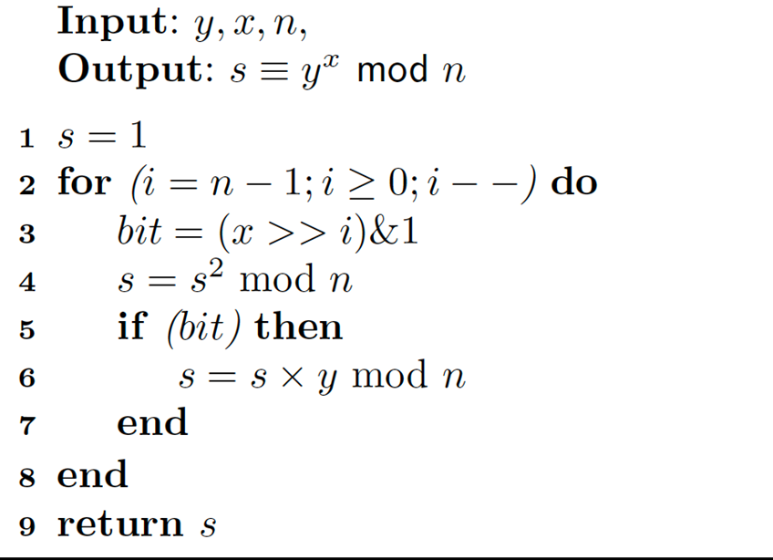
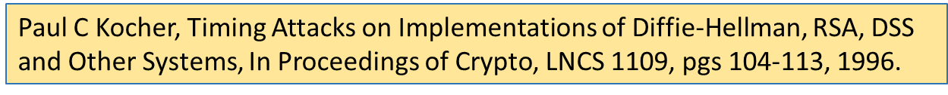
Example of SPA
We assume that the attacker knows the first b-1 bits, and wants to obtain the b th bit of the secret key.
Attacker knows x[0],…,x[b-2] and wants to determined x[b-1]

Slide 8
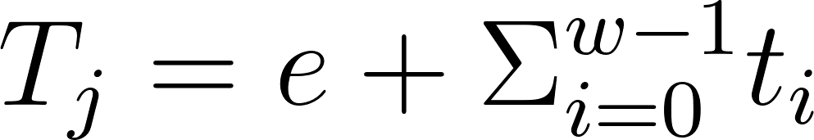
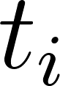
SPA Attack methodology
Attacker measures the time required to perform the loop a large number of times by varying the value of y.
Each observed timing can be denoted as , where is the time required for performing multiplication and squaring for bit i.
The measurement error, loop overhead are other sources of inaccuracies.
We assume that the attacker knows or has correctly evaluated in the previous iterations the first (b-1) bits: x[0],…,x[b-2]
Now the attacker guesses x[b-1]. Is it correct? 0 or 1?

Slide 9
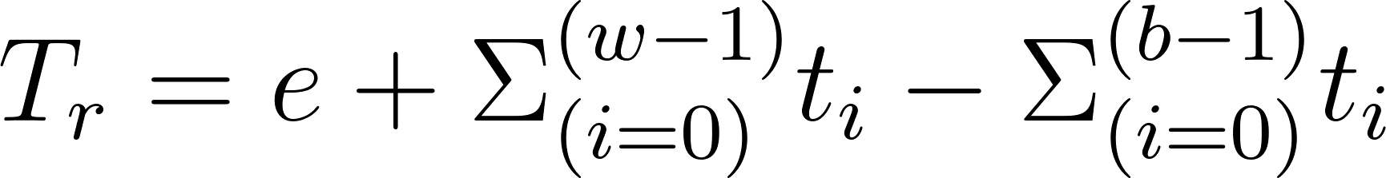
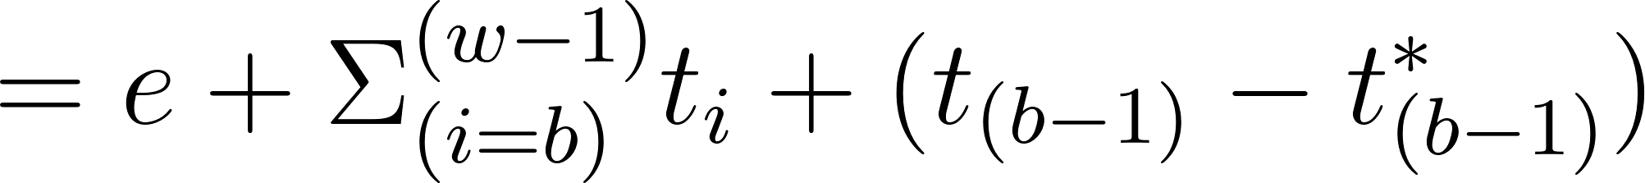
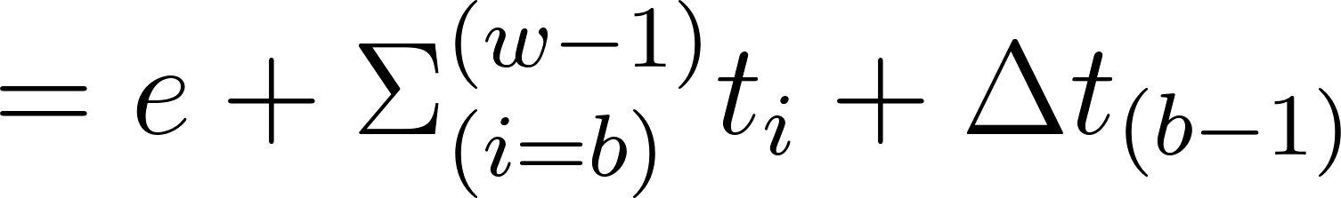
SPA Attack methodology (Contd.)
•If the guess is correct, subtracting from T yields
•Attacker obtains a distribution by varying the value of y and observing the above timing T_{r}.
•Assuming that the measurement error and the individual timings for the modular multiplier are independent, the variance of this distribution is:
• If the guess is correct: 𝑉𝑎𝑟(𝑇_{r})=𝑉𝑎𝑟(𝑒)+(𝑤−𝑏)𝑉𝑎𝑟(𝑡)
• If the guess is wrong: 𝑉𝑎𝑟(𝑇_{r})=𝑉𝑎𝑟(𝑒)+(𝑤−𝑏)𝑉𝑎𝑟(𝑡)+2𝑉𝑎𝑟(𝑡)

Slide 10
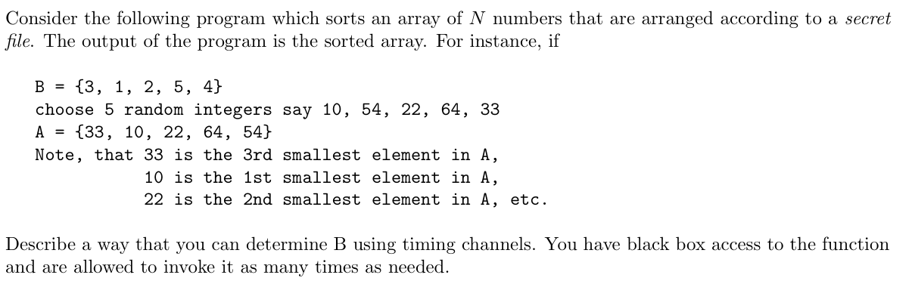
Quiz

Slide 11
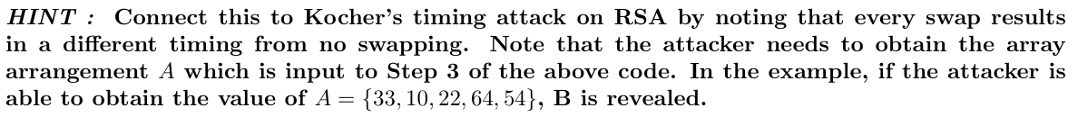
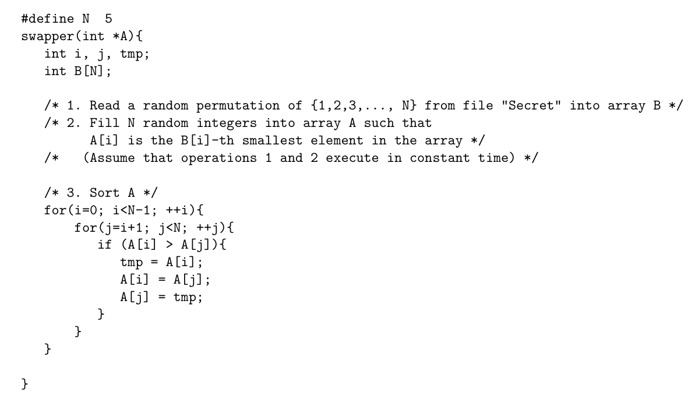
Quiz (Contd.)

Slide 12
Solution
Steps to Perform the Attack
Invoke the function multiple times Since B is chosen randomly from the file, we execute swapper() many times and measure its execution time.
Record execution times Each invocation sorts a different random A, but the number of swaps performed will differ based on the arrangement. By collecting enough timing samples, we can cluster execution times to different initial configurations of A.
Infer the initial arrangement of A
Sorting time depends on the number of swaps required.
If an input A is already sorted, the time taken is minimal.
If A is in reverse order, the time taken is maximum.
By analyzing execution time variations, we can reconstruct the relative order of elements in A.
Reconstruct B
Since A[i] is the B[i]-th smallest element, once we determine the pre-sorted sequence A, we can map the indices back to obtain B.

Slide 13
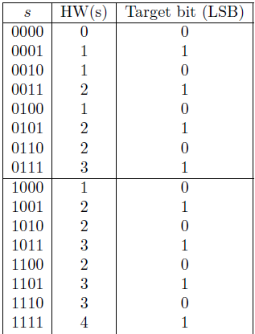
Principle of DPA
Assume power leakage follows Hamming Weight.
Divide the HW(s) into two bins:
0 bin: when LSB is 0
1 bin: when LSB is 1
Difference-of-Mean (DoM)=20/8-12/8=1
0,2,4,6,8,10,12,14
1,3,5,7,9,11,13,15
Bin-0
Bin-1

Slide 14
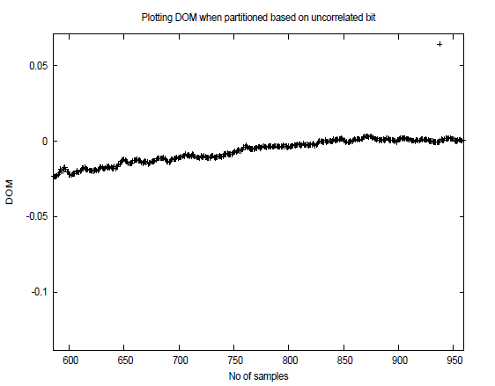
When the partitioning is done wrt. an uncorrelated bit?
Partitioning done by bits simulated using rand function in C.
Observe the DoM is close to 0, as expected!

Slide 15
A Toy DPA
Consider the operation z=y^{x}mod 256
Assume attacker knows first 4 bits of the secret, x (8 bit value).
Probability of guessing the next bit of x is ½ (with no side channel information).
Now we assume, the attacker varies y and obtains several power traces.
We simulate them through Hamming Weights.
Monitor the value of state ‘s’ and plot the HW of state ‘s’ as an indicator of power value.
x[7],x[6],x[5],x[4],x[3],x[2],x[1],x[0]

Slide 16
A Toy DPA
For a given y, the attacker now guesses the next bit and computes the probable s after the 3rd iteration (note that square and multiply starts from bit 6 to bit 0).
Based on the LSB of y, the corresponding trace is put into the 0 bin or 1 bin.
For every guess (there are 2 guesses) the DoM is computed and plotted.
The correct guess is expected to provide large DoM.

Slide 17
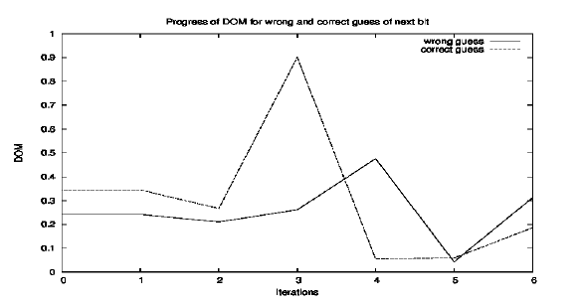
Toy DPA (Contd.)
Correct Key is 0x8F
Next bit is thus 1.
DoM computed after 2¹⁰ traces.
Significant difference: 0.9 vs 0.2!

Slide 18
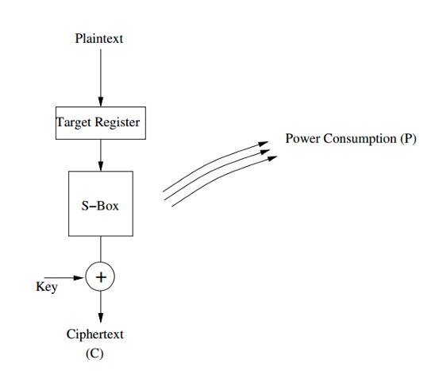
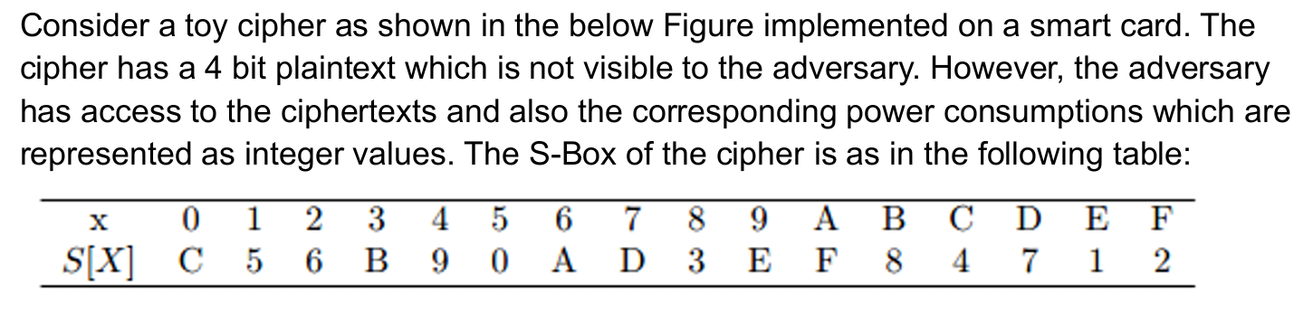
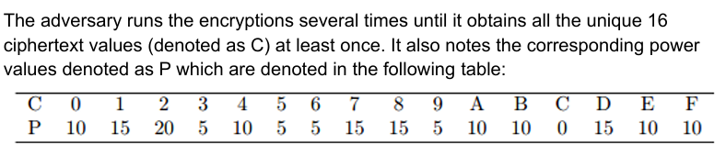
Example of DPA
The key is either 0101 or 1010. Apply the Difference-of-Mean (DOM) technique to determine which is the correct key byte. Target the MSB of the input of the S-Box. Correct key byte is__________

Slide 19
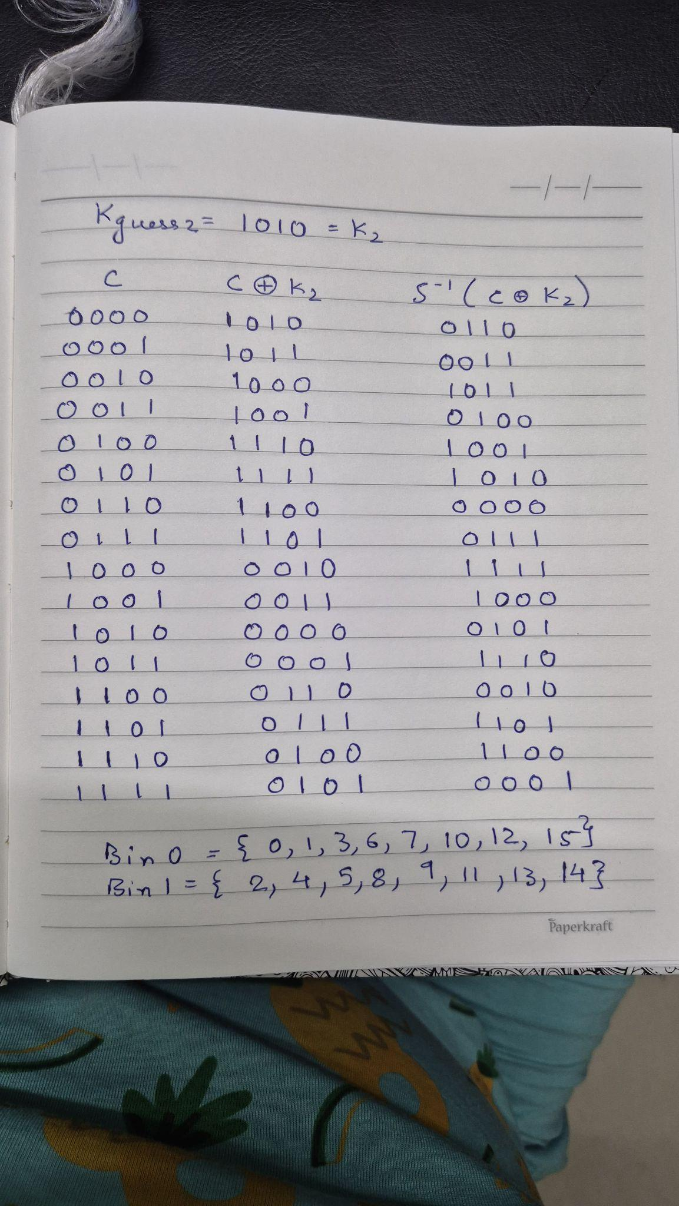
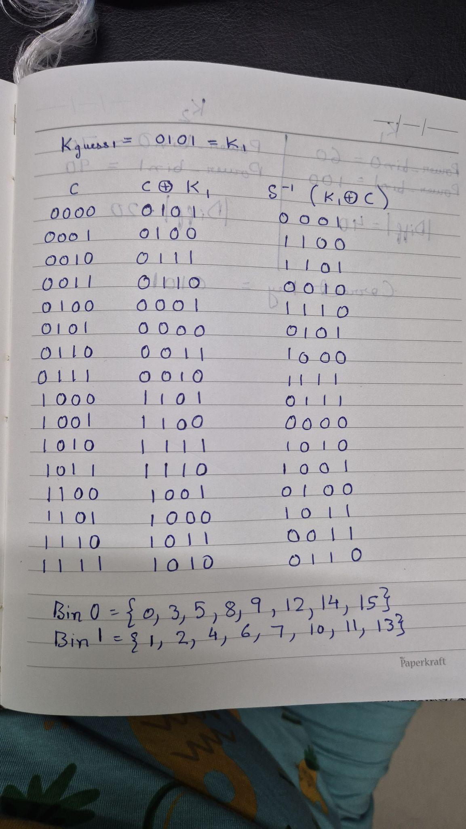
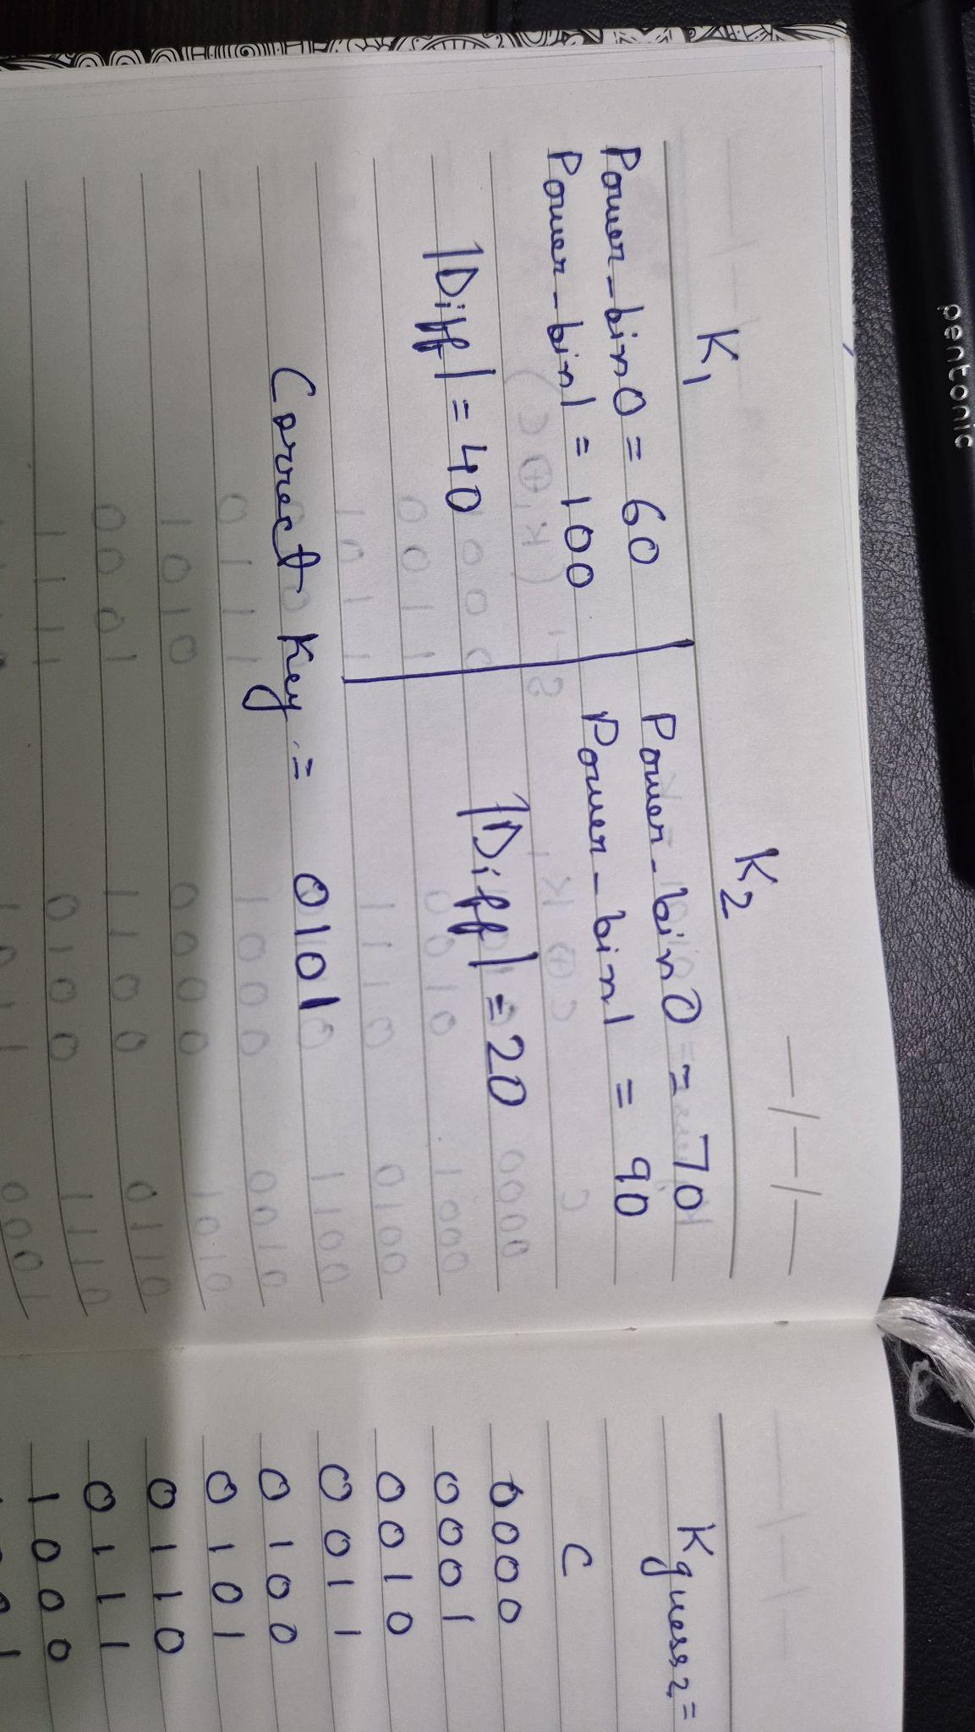
Solution

Slide 20
AES-128 Encryption
Plaintext Block
Secret Key
XOR key
Byte Substitution
Shift Rows
Loop 10 times
Mix Columns
(except for the last round)
RK1
RK2
RK3
Ciphertext Block
Add Round Key
RK10
Key Expansion

Slide 21
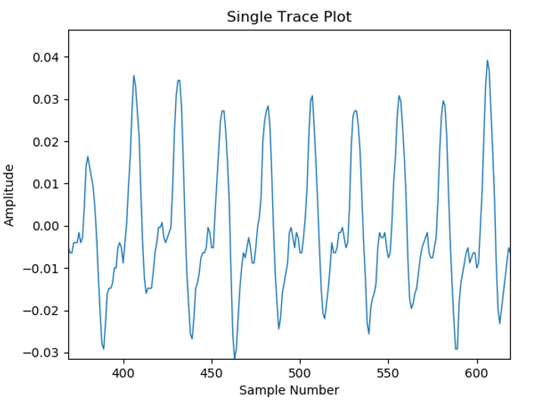
Real Power Trace
R10
R2
R3
R6
R8
R9
R4
R5
R7
R1

Slide 22
DPA for AES
Make power consumption measurement of about 1000 AES operations, 100000 data points / curve, (Ciphertext_{i}, Curve_{i})
Assume a key for an S-box of last round
Calculate last round S-box first bit output for each ciphertext using the assumed key
Divide the measurement into 2 groups (output 0 and 1)
Calculate the average curve of each group
Calculate the difference of two curves
Assumed correct key → spikes in the differential curve
Repeat 2-7 for other S-boxes
Exhaustive search for 8 bits of key.

Slide 23
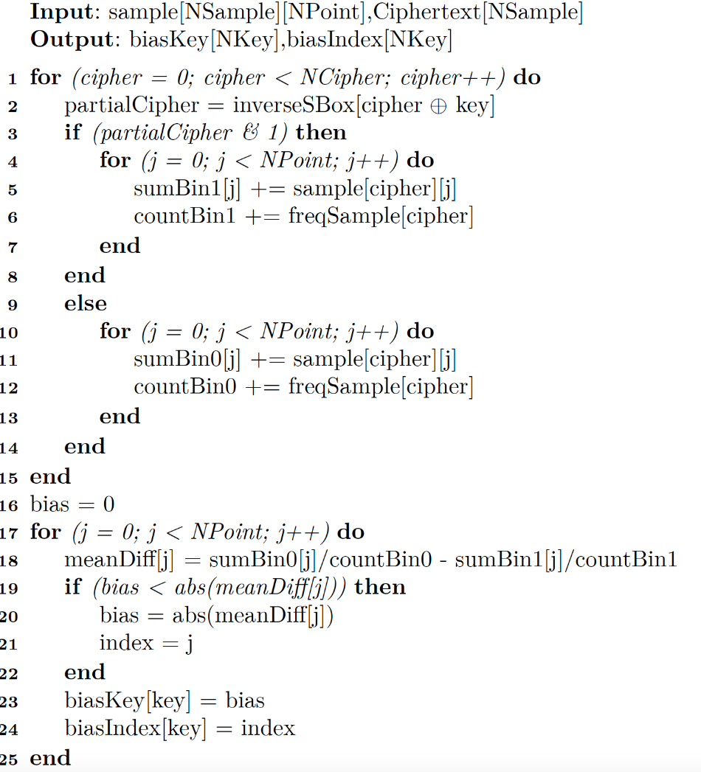
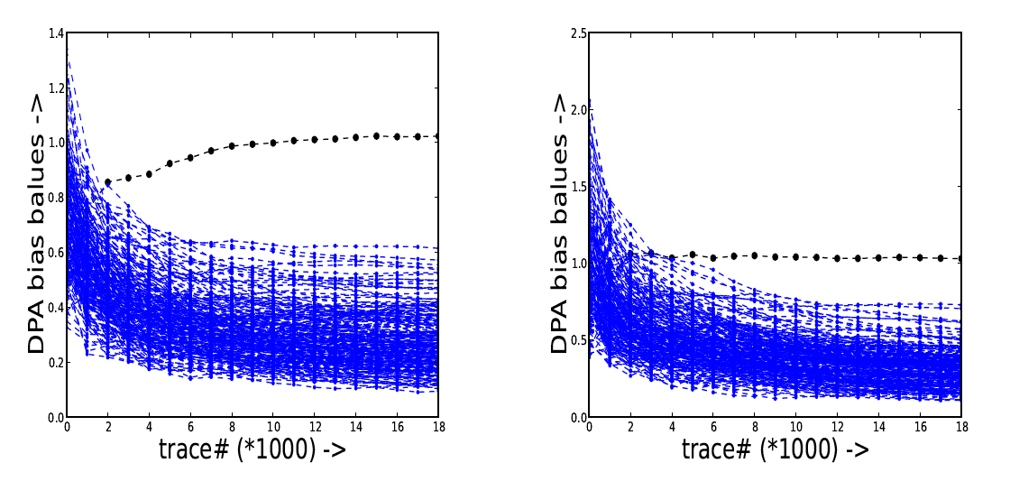
Algorithm for Performing DPA
DPA on first key byte of 10th Round of AES
Power is Simulated by Hamming Weight of the Registers after each Round
Power is Simulated by Hamming Weight of the Registers after each Round,with superimposed Gaussian Noise.

Slide 24
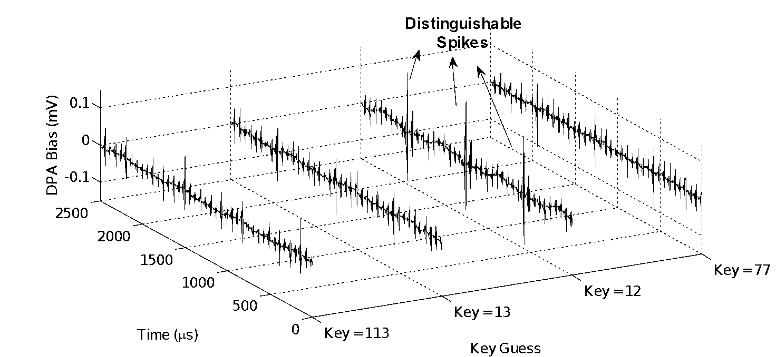
DPA Results - AES
SBOX – 11 BIT – 8 TRACE COUNT = 15,000

Slide 25
Real Power Trace
R10
R2
R3
R6
R8
R9
R4
R5
R7
R1

Slide 26
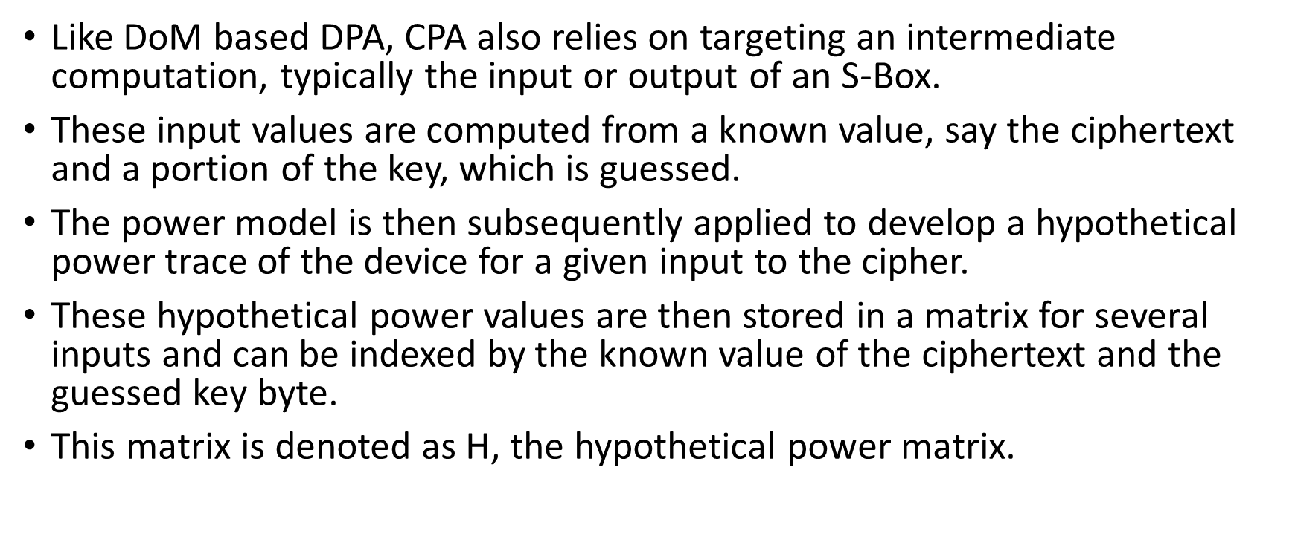
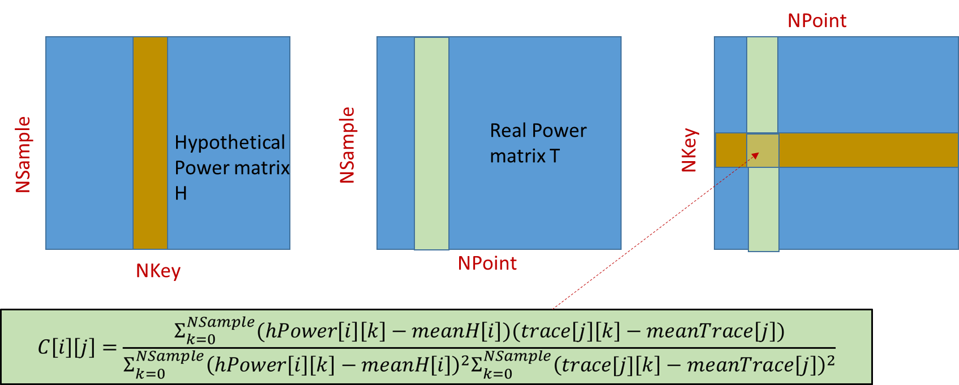
Correlational Power Attack (CPA)

Slide 27
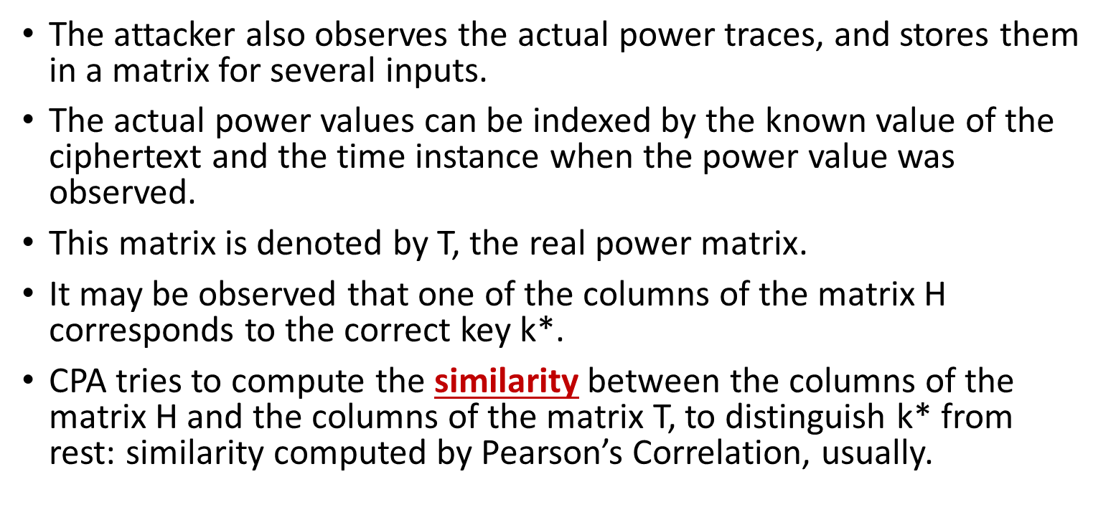
CPA (Contd.)

Slide 28
Computing Correlation Coefficient for Simulated Power Traces for AES
Like before, we simulate the power profile for the iterative AES, this time by using Hamming Distance power model applied on the state registers updated after each round.
The real power matrix is stored in the array trace[NSample][NPoint]
NSample: Number of Power Traces acquired
NPoint: Time instances for which the power values are observed.

Slide 29
AES-128 Encryption
Plaintext Block
Secret Key
XOR key
Byte Substitution
Shift Rows
Loop 10 times
Mix Columns
(except for the last round)
RK1
RK2
RK3
Ciphertext Block
Add Round Key
RK10
Key Expansion

Slide 30
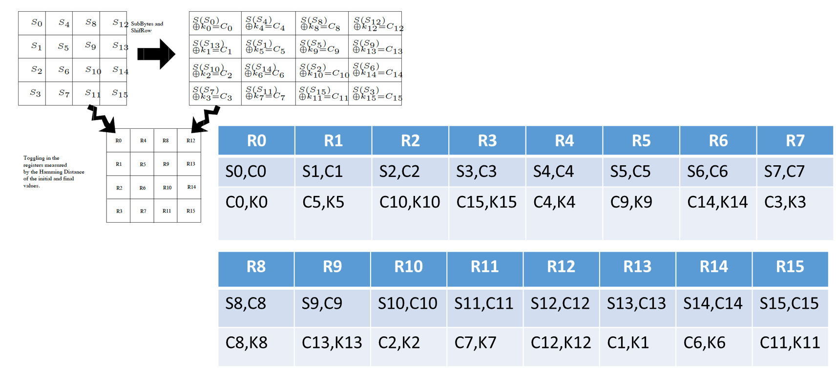
Calculating the Hypothetical Power

Slide 31
Computing the Correlation Matrix
Actual Power values for all the NSample encryptions are stored in the array trace[NSample][NPoint].
However, reflect as we are calculating hypothetical power using HD, the trick which we applied before for storing the traces compactly will not work.
Attacker first scans each column of this array and computes the average, and stores in meanTrace[NPoint].
Likewise, the hypothetical power is stored in the array hPower[NSample][NKey].
Attacker scans each column and stores in the array meanH[NKey]

Slide 32
Correlation Matrix

Slide 33
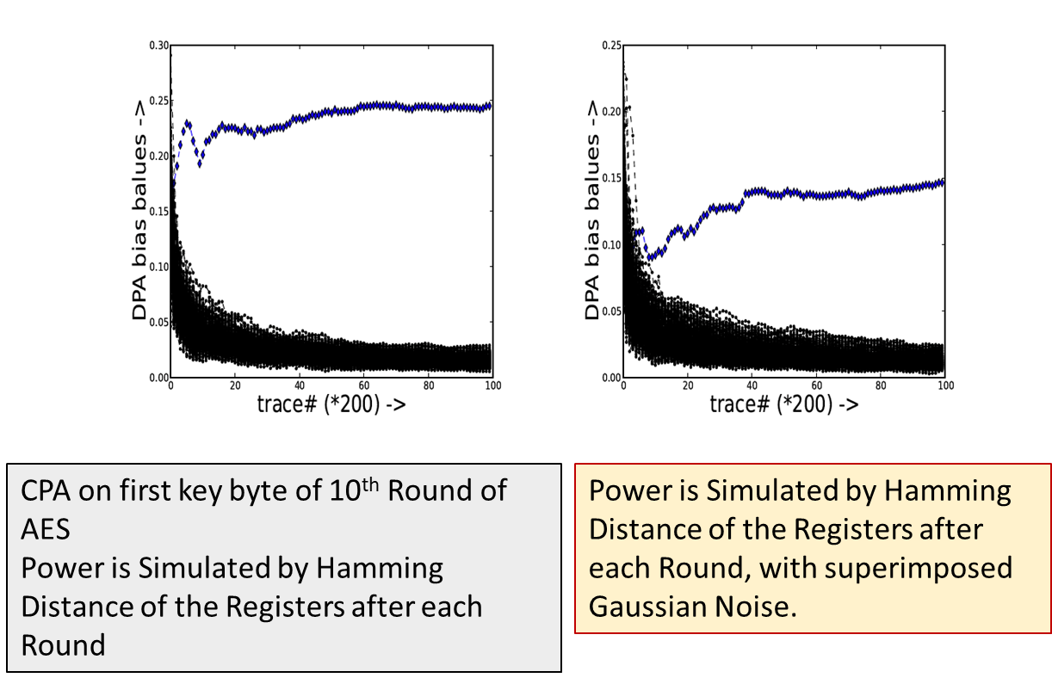
Experimental Results on Simulated Traces

Slide 34
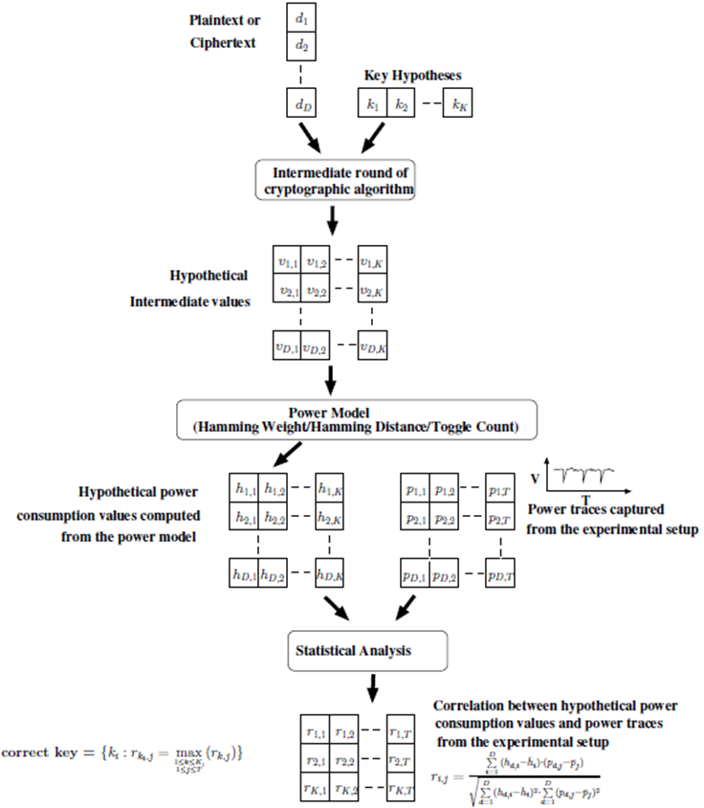
Summary of Correlation Power Analysis

Slide 35
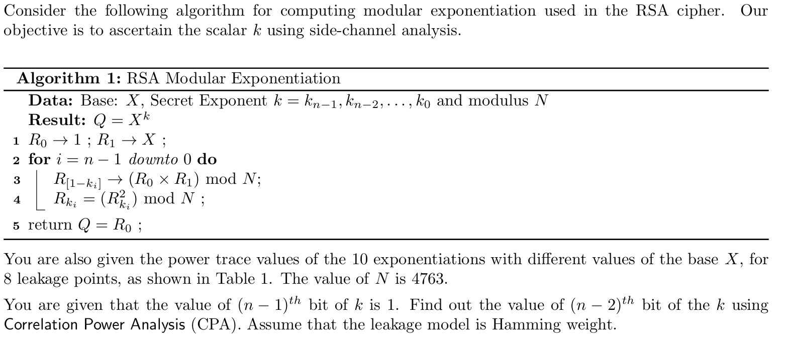
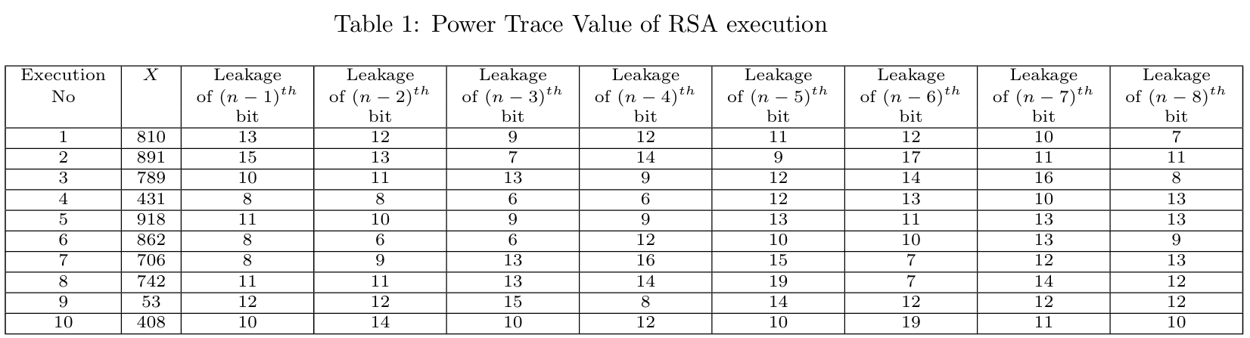
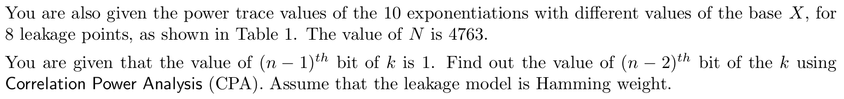
Example of CPA

Slide 36
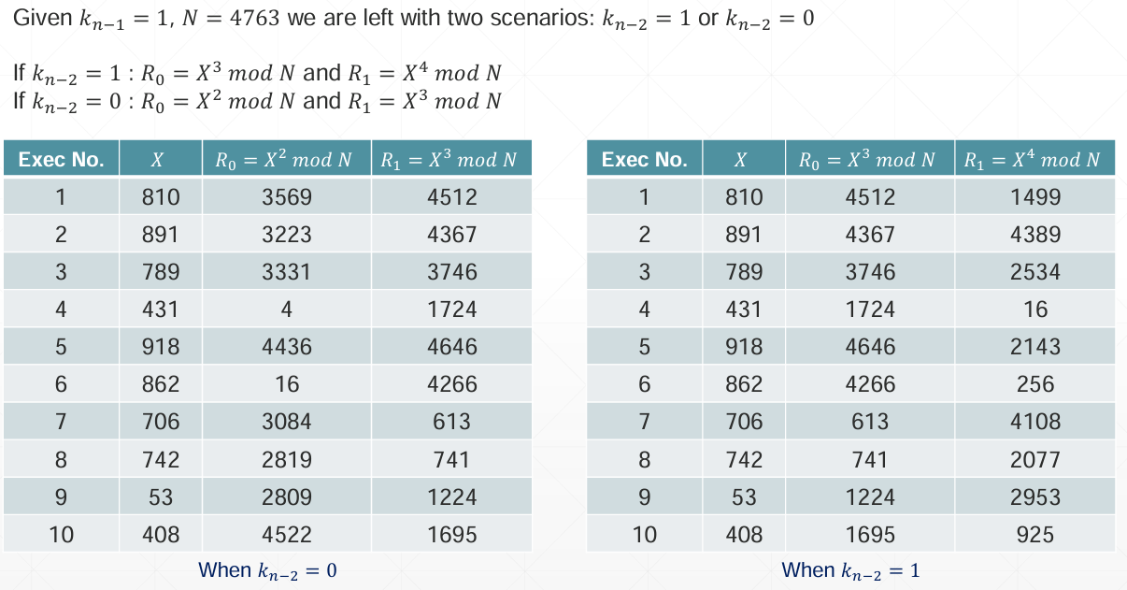
Solution

Slide 37
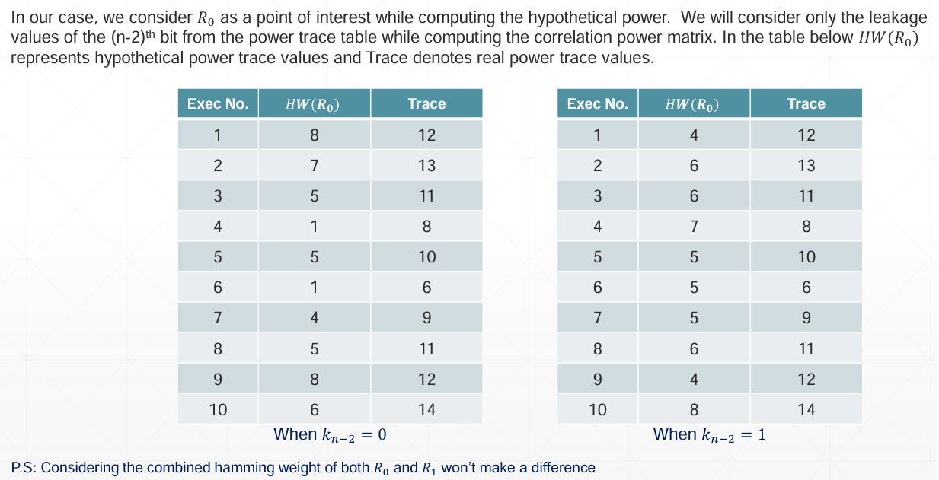
Solution

Slide 38
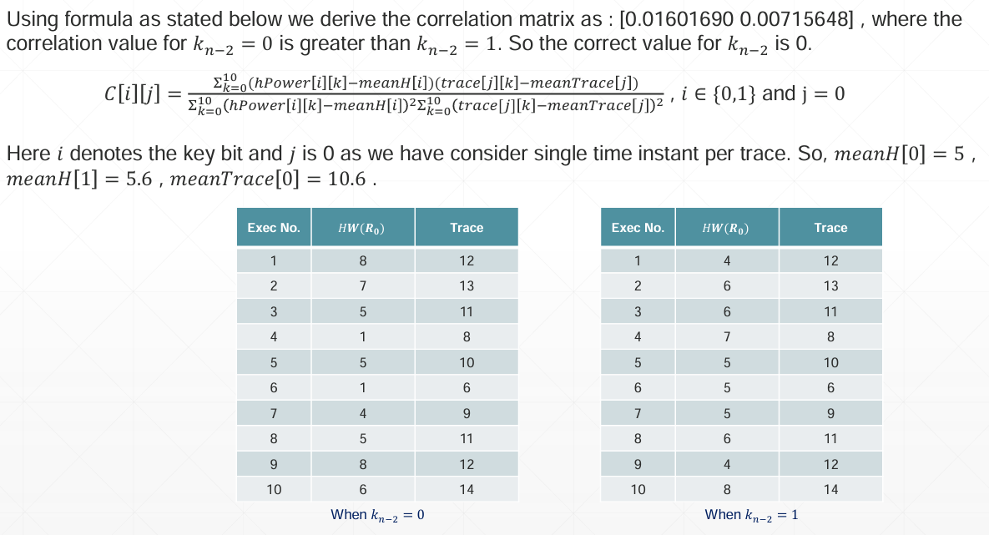
Solution

Slide 39
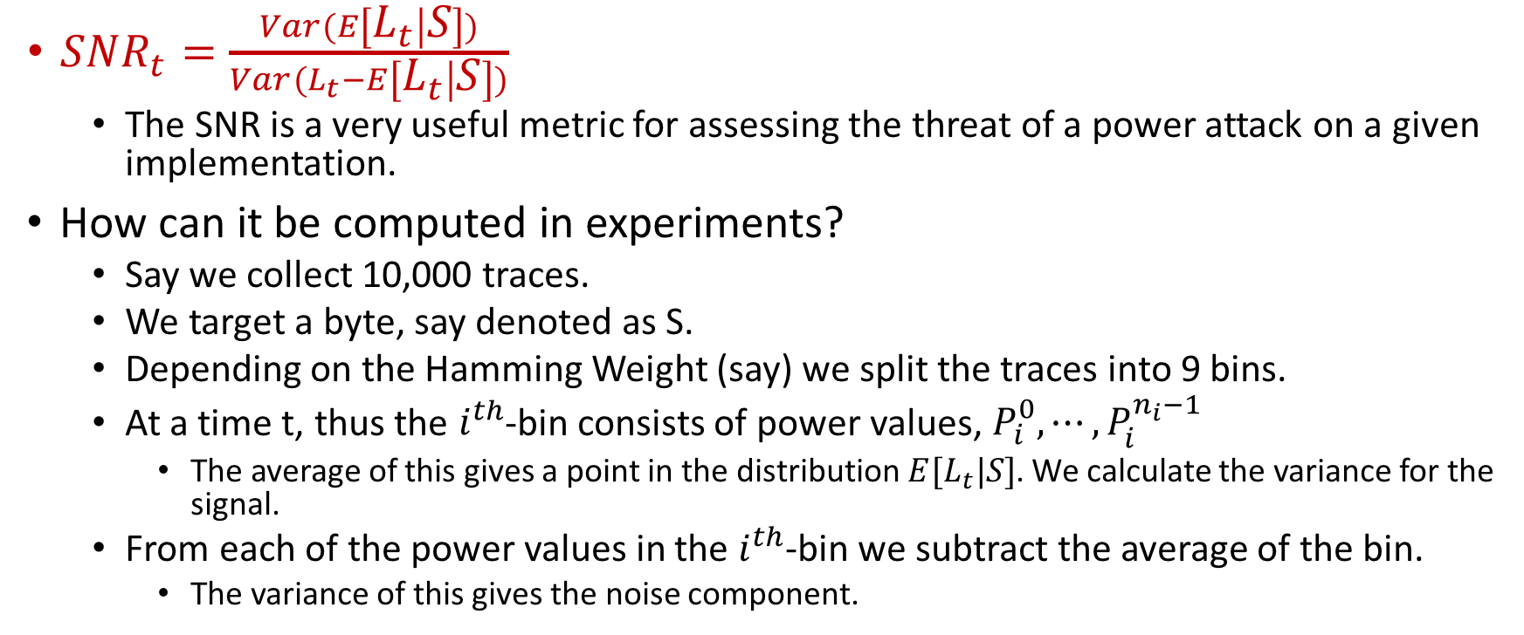
Signal-to-Noise Ratio (SNR)

Slide 40
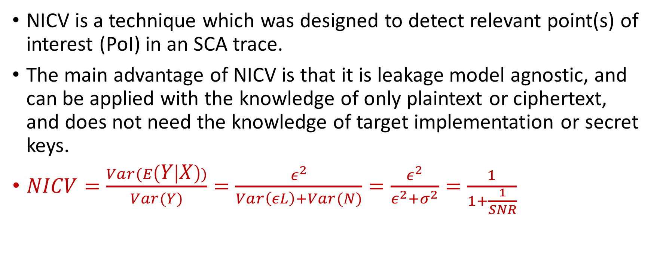
Normalized Inter Class Variance (NICV)

Slide 41
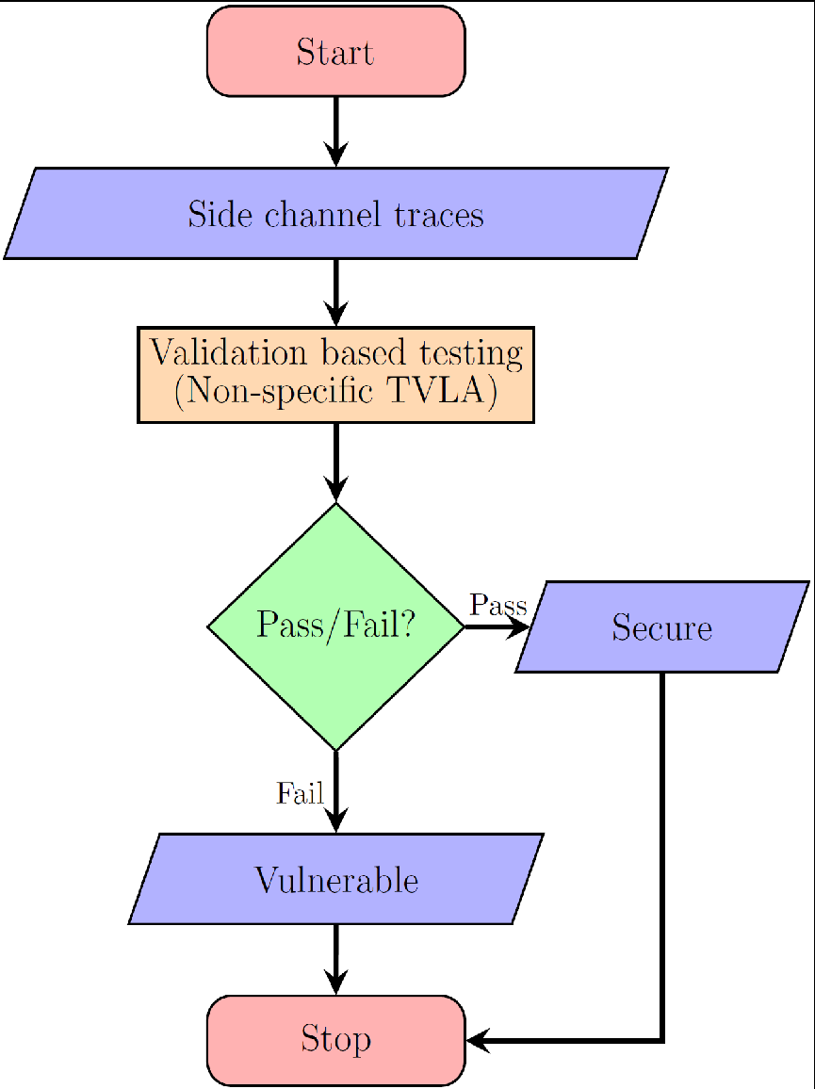
Test Vector Leakage Assessment (TVLA)
Test Vector Leakage Assessment (TVLA) is a direct application of Welch’s t-test on side channel leakage traces for detection of vulnerabilities
Non-specific TVLA: Partitions the trace based on public information, so can be useful for black box testing.
Acquire two sets of side channel traces
The first set corresponds to a fixed key and fixed plaintext
The second set contains traces corresponding to the same fixed key and random plaintext.

Slide 42
Thank You

